Slide 1
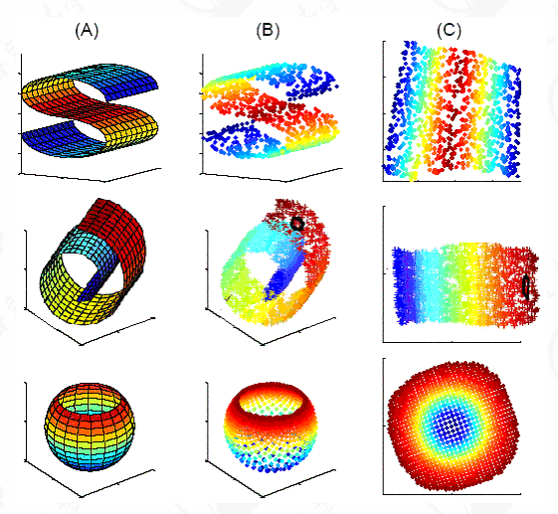
Dimensionality Reduction
PyData Pune
Nilesh Salunke

Slide 2
Dimensionality Reduction
Agenda :
What, Why and How of Dimensionality Reduction
Techniques involved in Dimensionality Reduction
Principal Component Analysis (PCA)
t-Distributed Stochastic Neighborhood Embedding (T-SNE)

Slide 3
Dimensionality Reduction
Def : Dimensionality reduction or Dimension reduction is the process of reducing the number of random variables under consideration by obtaining a set of principal variables.

Slide 4
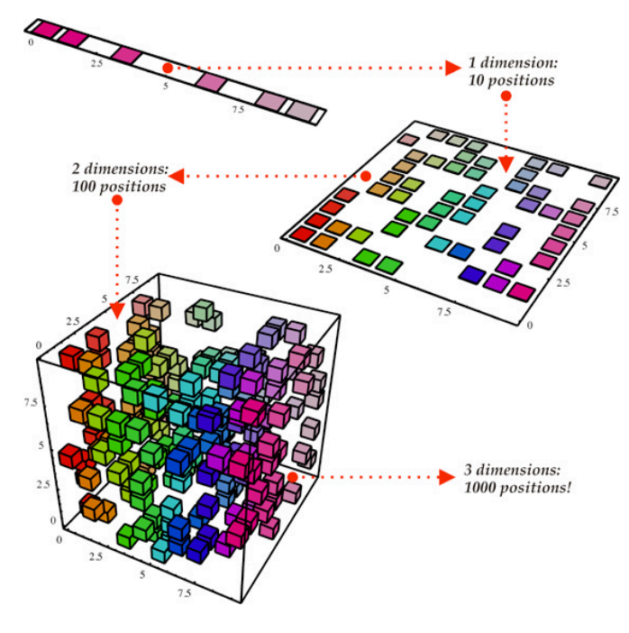

Slide 5
What are the benefits of Dimension Reduction :
Helps in data compressing and reducing the storage space required
Fastens the time required for performing same computations. Also less dimensions can allow usage of algorithms unfit for a large number of dimensions
Takes care of multi-collinearity that improves the model performance. It removes redundant features. For example: there is no point in storing a value in two different units (meters and inches).
Reducing the dimensions of data to 2D or 3D may allow us to plot and visualize it precisely. You can then observe patterns more clearly. Image coming up shows, how a 3D data is converted into 2D and then to 1D.

Slide 6
It can be divided into feature selection and feature extraction
Feature Selection : approaches try to find a subset of the original variables (also called features or attributes). There are three strategies: the filter strategy, the wrapper strategy (e.g. by using Algorithms like Decision Trees and Random Forest), and the embedded strategy (features are selected to add or be removed while building the model based on the prediction errors)
Feature Extraction : transforms the data in the high-Dimensional Space to a space of fewer dimensions. The data transformation may be linear, as in principal component analysis (PCA), but many non Linear Dimensionality Reduction techniques also exist like T-SNE.

Slide 7
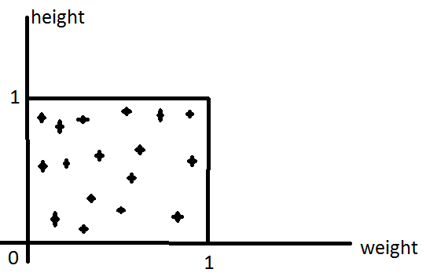
Data Preprocessing -
Column Normalization : We transform the data in such a way that the values will lie between
0 and 1.
Why we do Column Normalization ?
To bring data under one scale.
Compressing and Expanding techniques are
involved in it.
Height (cm) | Weight (Kgs)
162 | 55
173 | 68
170 | 65
…….. | ……….

Slide 8
Variance measures how far a data set is spread out. The technical definition is “The average of the squared differences from the mean “
Standard Deviation
The square root of the variance is the standard deviation. While var. gives you a rough idea of spread, the standard deviation is more concrete, giving you exact distances from the mean.

Slide 9
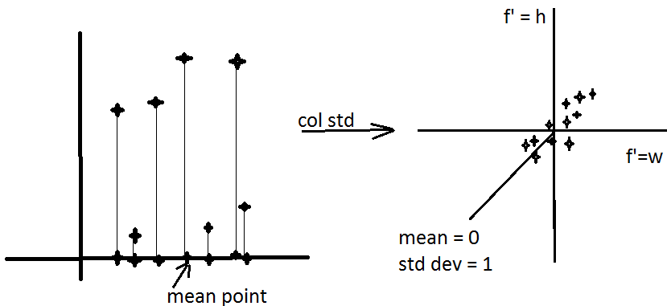
In normalization we get rid of scales for each features.
In Column Standardization we transform data in such a way that the mean is zero and std deviation is One

Slide 10
What is Principal Component Analysis PCA ?
Principal component analysis (PCA) is a statistical procedure that uses an orthogonal transformation to convert a set of observations of possibly correlated variables into a set of values of linearly uncorrelated variables called principal components.
Principal component analysis (PCA) is a technique used for identification of a smaller number of uncorrelated variables known as principal components from a larger set of data.
If we have a D-dimensional data, then we can reduce the same into D’ dimensional data.

Slide 11
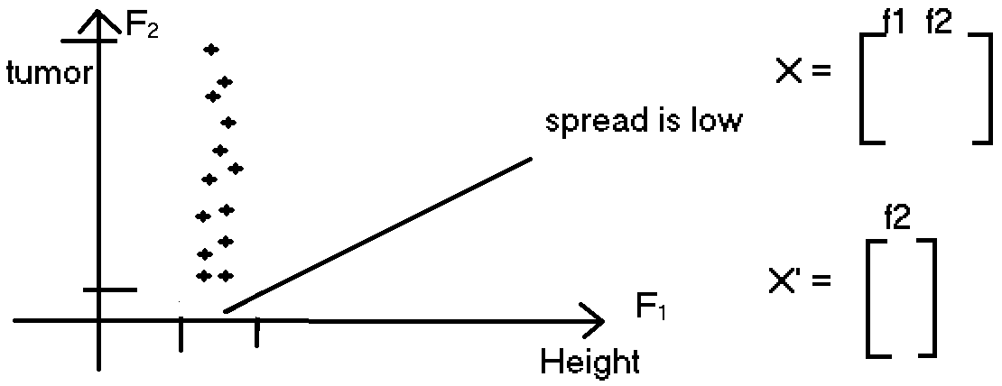

Slide 12
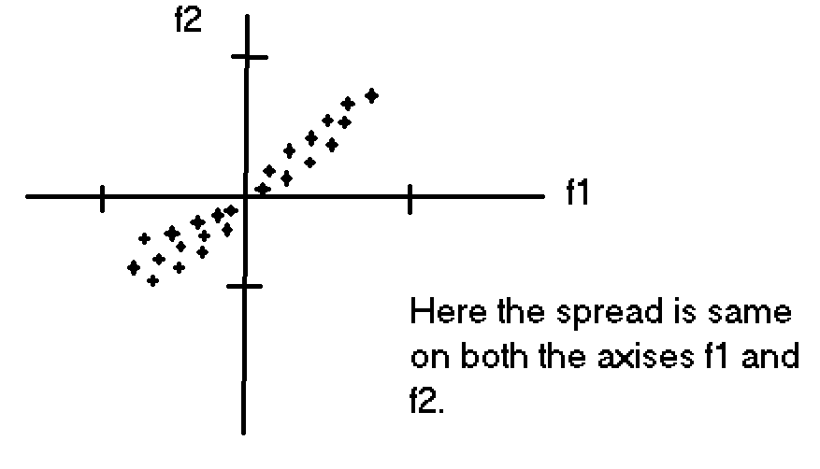
What if Information (spread) is equal on both axis ?

Slide 13
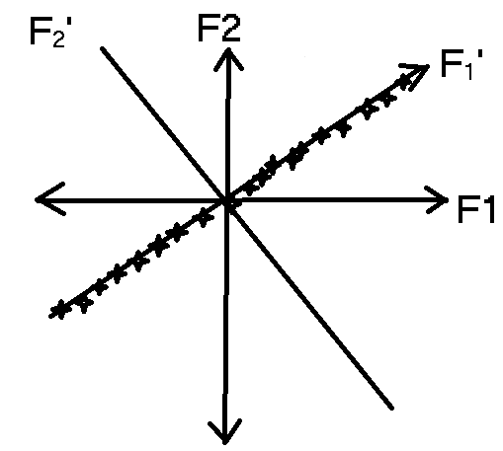
We consider a direction where the spread is wide.
Steps 1 : find f₁‘ and f₂’ such that the spread on f₂’ is small as compared to f₁’
Step 2 : drop f₂’
Step 3 : project all x_{i} ‘s onto f₁’then we can convert 2D data to 1D data.
We want to find a direction f₁‘ such that variance of x_{i}’s projected onto f₁‘ is maximum, so that we can drop f₂‘. Rotate f₁ to f₁‘ by theta, so as to get maximum variance.
We are preserving the direction with maximal spread/variance in information.

Slide 14
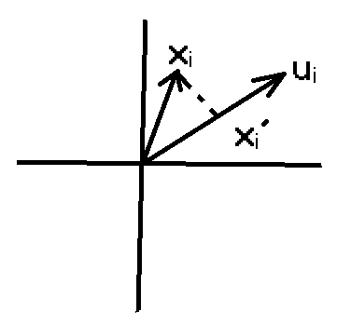
Projection
X_{i} = proj_{u(i)} x_{i} = u_{i} . X_{i}
||U₁||²
Since u₁ is a direction and x_{i} is also a direction, we can count them as features and if we want to multiply them, u₁ needs to be taken as a transform of u₁
It can be written as u₁^{T} . X_{i}

Slide 15


Task is to find u₁ such that variance of {proj _{u(i)}x_{i} } from i = 1 to n, is maximal
Var {u₁^{T} x_{i}} from i = 1 to n :
1/n sum (i:1 to n) (u₁^{T}x_{i} – u₁^{T} x_{i})²
Now if X is column std, then the mean becomes zero and we get the equation as follows :
Var {u₁^{T} x_{i}} from i = 1 to n :

Slide 16
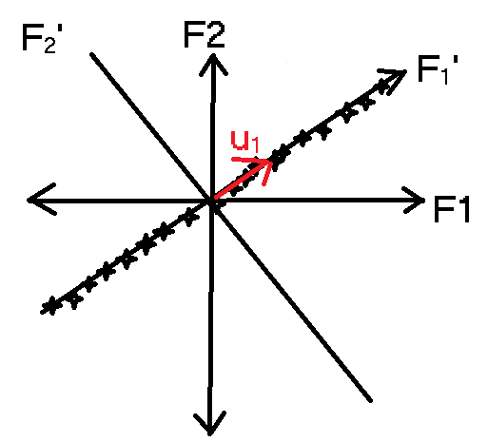
The direction is important and we represent direction using unit vector whose length is 1
||u|| = 1
Why?
So that it gives us the maximum variance.

Slide 17
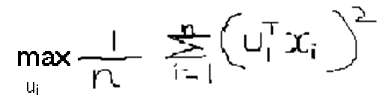

Now we need to optimize
Here max of u_{i} is max variance. We follow a mathematical way in order to understand the solution of this optimization problem.
Lets understand what are Eigen values and Eigen Vectors, Why?
Because this would server our purpose to find the direction and magnitude.
Lets say if we have D-dimension data, then the eigen value can be written as
v1, v2, v3……………vd

Slide 18


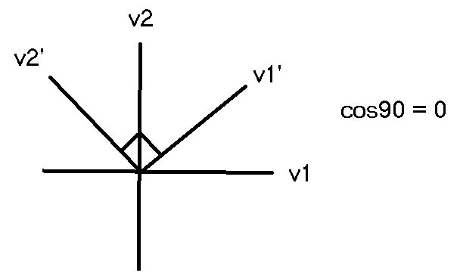
If we sort the eigen vectors and values in descending order then :
We see a formation like :
we can say that is maximal and so on..
Similary v1 >= v2 >= v3……….>= vd
Important Property of Eigen Vectors:
If we take any 2 Eigen Vectors, they are perpendicular to each other.
If v1 and v2 are 2 vectors then :
v₁^{T} . v2 = 0. Since the angle theta is 90, therefore cos90 = 0(zero).

Slide 19
We can relate our direction u_{i} = v1 = Eigen vector of corresponding to largest eigen value
Summary of Steps :
Given a dataset X, do column standardization of X
Compute covariance of X, such that S = X^{T} . X
Compute Eigen values and vectors of S, then we get
v1, v2, v3……………vd
U1 = v1, hence we get the required direction.
Why?
Its Eigen vector corresponding to largest Eigen value

Slide 20
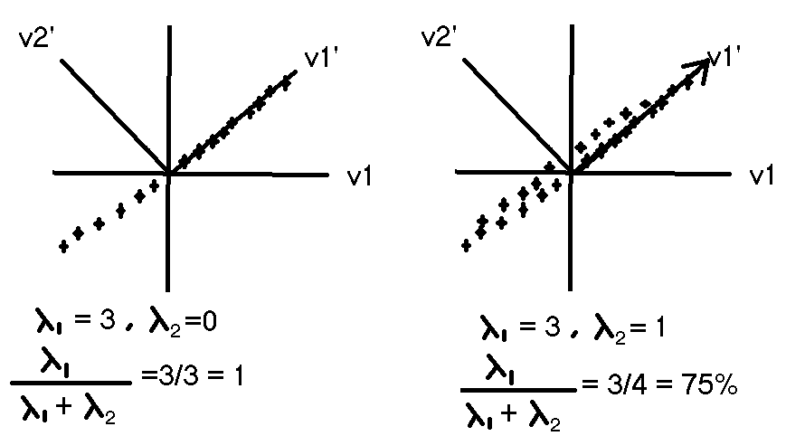
This is the % of variance of data that is already explained. Ratio of lambda 1 to sum of lambda i ’s is % of variance explained or say information preserved.

Slide 21
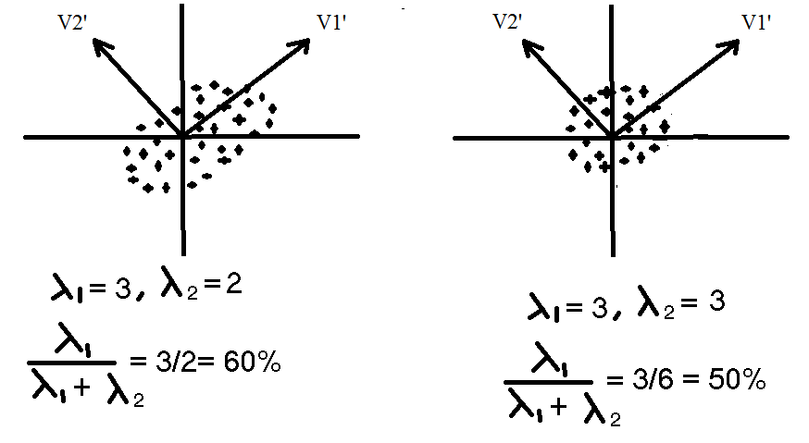

Slide 22
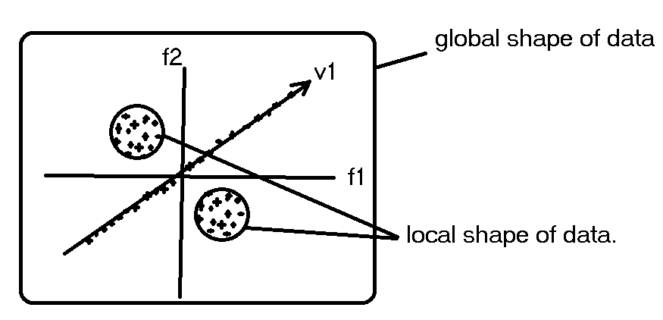
T-SNE
Student’s Distributed / T-Distributed Stochastic Neighborhood Embedding T-SNE.
2008 launched technique by Laurens Maaten and Geoffrey Hinton.
PCA tries to preserve global shape of data, whereas TSNE preserves local shape too.

Slide 23
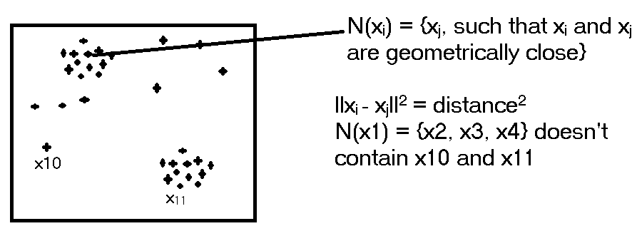
What is Neighborhood ?
Neighborhood :
Here we see that the neighboring data points close to x1 are x2, x3 and x4

Slide 24
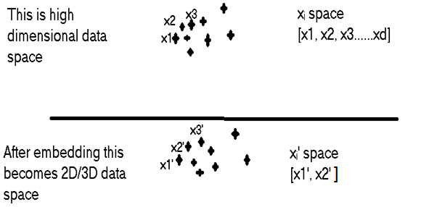
What is Embedding ?
[here] Embedding means for every point in high dimensional space, we create a point in 2D/3D.
Taking points one by one and placing them for every point x_{i} in high dimension space, we find a point x_{i}, such that even the components remains same.
x_{i} = [x1, x2…xd] kept same as [x1’, x2’ ]

Slide 25
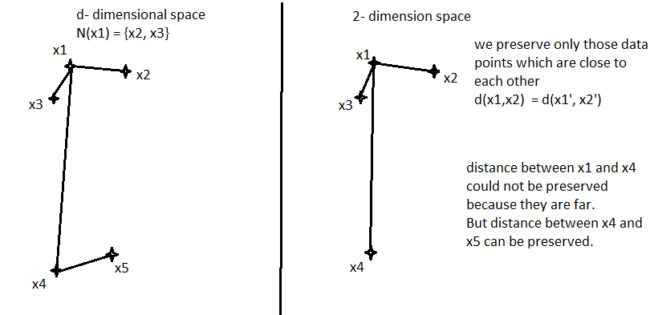

Slide 26

Q&A

Slide 27
Thank You!!!

